Slide 1




Enhancing Conversational AI Model Performance and Explainability for Sinhala-English Bilingual Speakers
develop
train
interact
maintain
validate
deploy
release
kolloqe

Slide 2

Enhancing Conversational AI Model Performance and Explainability for Sinhala-English Bilingual Speakers
2022-056
Progress Presentation - II

Slide 3

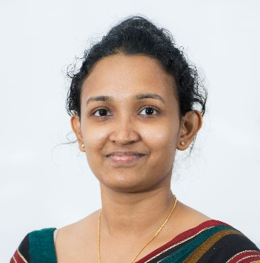




The Team
Supervisor
Dr. Lakmini Abeywardhana
Co – Supervisor
Ms. Dinuka Wijendra
Dissanayake D.M.I.M.
IT19069432
(Explainable AI)
Hameed M.S.
IT19064932
(Codeless Interface)
Jayasinghe D.T.
IT19075754
(Language & Interactions)
Sakalasooriya S.A.H.A.
IT19051208
(Entity Annotation)

Slide 4




2
Service organizations have adopted chatbots since 2018
3
Decision Makers who stated their organization uses chatbots
67%
Increase
65%
of Customers prefer chatbots for
simple matters
2020
38%
in organizational chatbot utilization
2018
23%
Source
https://www.salesforce.com/resources/research-reports/state-of-service/

Slide 5


Chatbot development lifecycle
Decision Makers who stated their organization uses chatbots
67%
Increase
65%
of Customers prefer chatbots for
simple matters
2020
38%
End-users
Consume chatbots
Organizations
Maintain chatbots
Chatbot Providers
Build chatbots
in organizational chatbot utilization
2018
23%
87%
24%
Sinhala Speakers
Service Teams use AI
* While there are 28% Tamil speakers and 23% English speakers.
On top of that 34% more are planning on utilizing AI and Machine Learning
Querying and Code-switching
Entity Recognition
* Source
Central
Intelligence
Agency
https://www.cia.gov/the-world-factbook/countries/sri-lanka/

Slide 6
87%
24%
Sinhala Speakers
Service Teams use AI
* While there are 28% Tamil speakers and 23% English speakers.
On top of that 34% more are planning on utilizing AI and Machine Learning
Querying and Code-switching
Entity Recognition
* Source
Central
Intelligence
Agency
https://www.cia.gov/the-world-factbook/countries/sri-lanka/

Slide 7
87%
24%
Sinhala Speakers
Service Teams use AI
* While there are 28% Tamil speakers and 23% English speakers.
On top of that 34% more are planning on utilizing AI and Machine Learning
ML Frameworks
Model Validation
Model Explainability
Source
https://www.salesforce.com/resources/research-reports/state-of-service/

Slide 8
Chatbot development lifecycle
End-users
Consume chatbots
Organizations
Maintain chatbots
Chatbot Providers
Build chatbots
interact
test
develop
train
validate
deploy
release
* Maintenance is done constantly
after the release
maintain

Slide 9
Chatbot development lifecycle
End-users
Consume chatbots
Organizations
Maintain chatbots
Chatbot Providers
Build chatbots
interact
develop
train
validate
deploy
release
maintain

Slide 10
develop
train
interact
maintain
validate
deploy
release
kolloqe

Slide 11











Sysyem Architecture
Code-switchable Keyboard
Rule-based keyboard interface
socket io
Deployed Rasa Model
Chat Widget
End Users
Entity Annotating
Reverse Stemming, N-grams, Cosine Similarity
Machine Learning Pipeline Improvements
JS, YAML
Developers
& Testers
Accuracy Curves
TensorBoard, JS
Intent Classification Model Explanations
DIME, Feature Importance
Development Console
Trained Rasa Models
https

Slide 12






Kolloqe
Uniqueness
DialogFlow by Google
Rasa Open Source
Microsoft LUIS
Amazon Lex

Slide 13
Kolloqe
DialogFlow by Google
Rasa Open Source
Microsoft LUIS
Amazon Lex

Slide 14
Sinhalese
Support for
Kolloqe
DialogFlow by Google
Rasa Open Source
Microsoft LUIS
Amazon Lex

Slide 15
Sinhalese
Support for
DialogFlow by Google
Rasa Open Source
Kolloqe
Microsoft LUIS
Amazon Lex

Slide 16
Sinhalese
Code Switch-able Keyboard
Support for
DialogFlow by Google
Rasa Open Source
Kolloqe
Microsoft LUIS
Amazon Lex
DialogFlow by Google
Rasa Open Source
Kolloqe
Microsoft LUIS
Amazon Lex

Slide 17
Code Switch-able Keyboard
Sinhala Entity Annotation and Suggestions
Support for
DialogFlow by Google
Rasa Open Source
Kolloqe
Microsoft LUIS
Amazon Lex

Slide 18
Sinhala Entity Annotation and Suggestions
No-code Development Console
Support for
DialogFlow by Google
Rasa Open Source
Kolloqe
Microsoft LUIS
Amazon Lex

Slide 19
No-code Development Console
No-code NLU Pipeline Configuration
Support for
DialogFlow by Google
Rasa Open Source
Kolloqe
Microsoft LUIS
Amazon Lex

Slide 20
No-code NLU Pipeline Configuration
No-code Model Evaluation
Support for
DialogFlow by Google
Rasa Open Source
Kolloqe
Microsoft LUIS
Amazon Lex

Slide 21
No-code Model Evaluation
Model Explainability
Support for
DialogFlow by Google
Rasa Open Source
Kolloqe
Microsoft LUIS
Amazon Lex

Slide 22



Model Explainability
Support for
kolloqe
DialogFlow by Google
Rasa Open Source
Microsoft LUIS
Amazon Lex
NLP Tools for Sinhalese
Simple No-Code Development Console
Model Evaluations & Explainability

Slide 23

98%
SIENA: Annotating entities using
reverse-stemming & other techniques
to develop a data annotation tool for code-mixed text data for efficient custom entity tagging.
Sakalasooriya S.A.H.A.
IT19051208
Data Science

Slide 24




Research Problem
Why custom name entity tagging is very time consuming?💤🥱
Any solution?
🤔

Slide 25
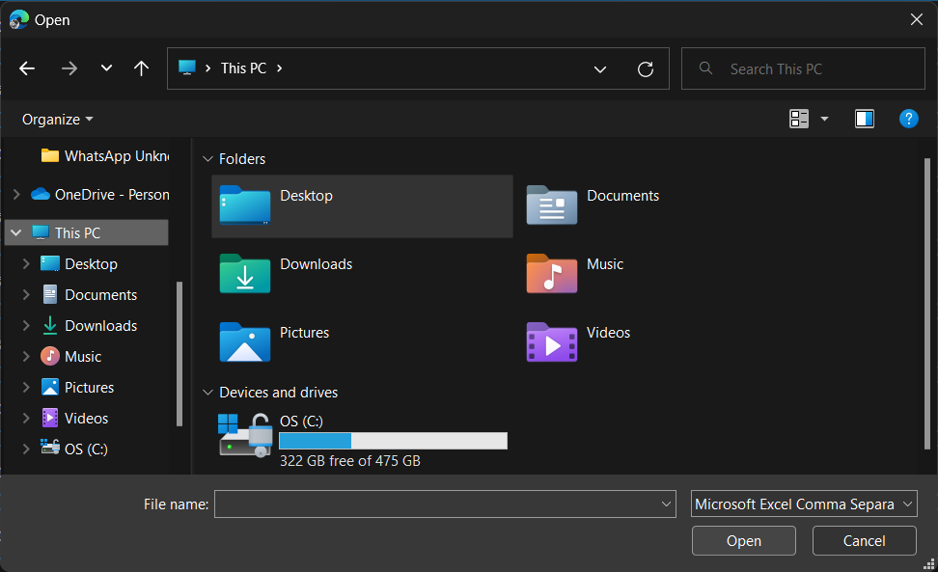
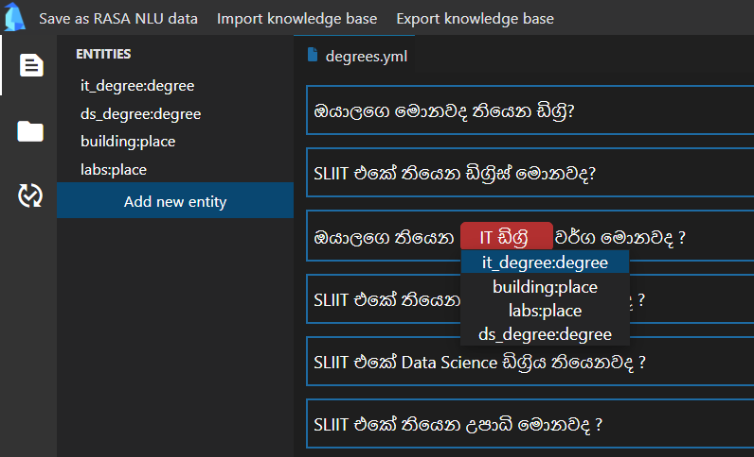
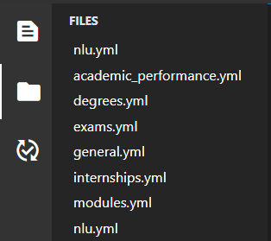
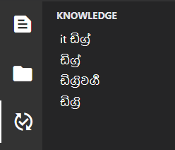
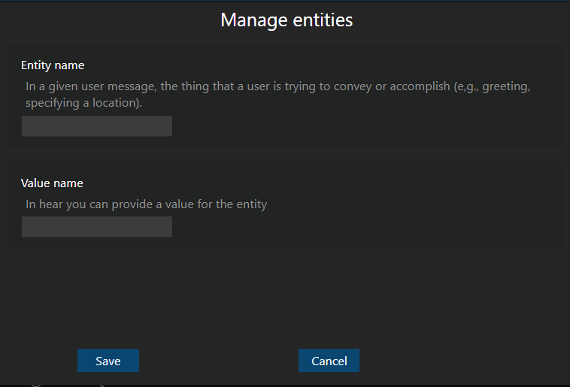

Solution

Slide 26





Functional Requirements
Recommend name entities
Import corpus into SINEA
Export annotated text from SIENA
Import portable knowledge base into SINEA
Export portable knowledge base from SINEA

Slide 27
Non-functional Requirements
Make as a SIENA secure software
Able to easily maintain
Easily install
SIENA should be reliable
SIENA should be secure

Slide 28







Solution Flow
config.SIENA
Stemming
Stemmed word list
}
Find similar words
Rasa NLU data extractor
SIENA UI
🔍
entities.SIENA
Bot dataset
Provide suggestions
inprogress.SIENA
User
SIENA Server

Slide 29
Methodology Reverse stemming
IT ඩිග්‍රිවල
IT ඩිග්‍රියක
2
3
IT ඩිග්‍රි: deg_type
1
Stem “IT ඩිග්‍රිවල” into base word and map it to the given entity type
1
2
Stem “IT ඩිග්‍රියක” into base word and get entity type of base word
3
Suggest entity type of base word to “IT ඩිග්‍රියක”

Slide 30
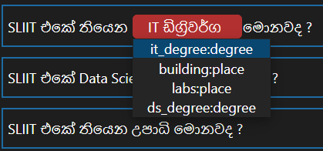
Sort recommendations according to the similarly
Cosine similarly
}
Highest score
Score
Least score
Base word list
N- gram similarly
Slightly different base forms due to:
Spelling mistakes
Different Singlish typing patterns
Limitations of stemming algorithm

Slide 31
Sub Objectives
98% * 0.4
98% * 0.2
Define the Recommendation hierarchy (algorithms)
Make SIENA Compatible with Frameworks
98% * 0.1
98% * 0.3
Make Knowledge base as Moduler Component
Develop Visualizations Technique to Provide User Friendly Suggestions
98%
Overall completion = (objective completion) x (objective weight) =

Slide 32
Work Breakdown Structure
SIENA
1
Data Preparation
2
Algorithm Development
3
UI Development
NER model Implementation
Deployment
4
5
Data Collection
Revere stemming approach development
SIENA CLI
Build NLP pipeline
Update the GIT Repository
Data Augmentation
SIENA GUI
Build NER model
Set up GCP Instance
Word-wise cosine similarity approach development
Data Deduplication
Flask server implementation
Deploy SIENA
Data Preprocessing
N-gram approach development
Algorithm evaluation
Completed
In-progress (90% - 100%)
Pending

Slide 33




Technologies
Backend Development
Frontend Development
Project Management
Python
pandas
HTML
Git
GitLab
GitHub
Rasa
Flask
PyPI
Test PyPI
Secure flask server
.SIENA files to save configuration data

Slide 34

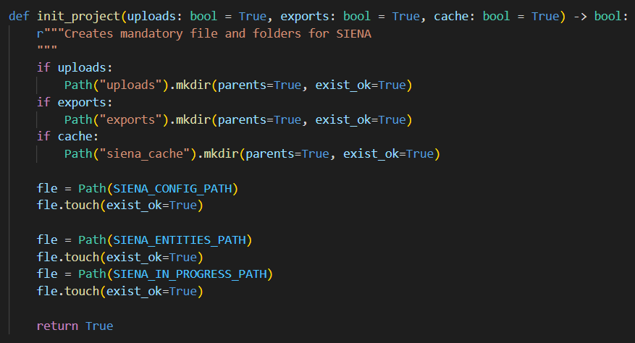
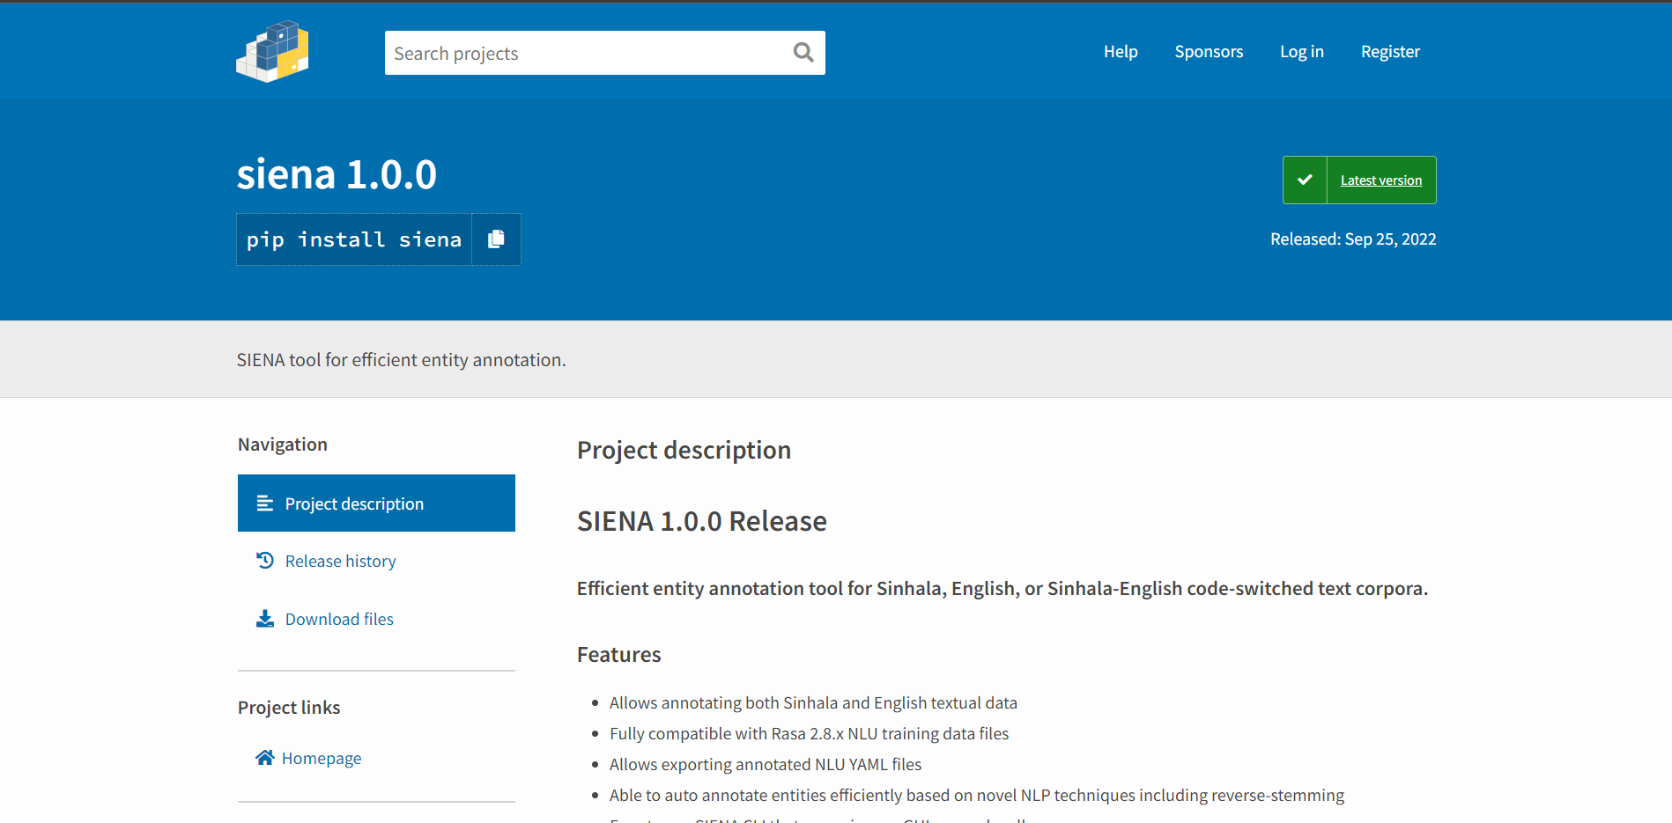
Best practices
Docstrings & PEP-8 Style
Available on pypi

Slide 35
References
[1] Anastasia Zhukova, Felix Hamborg, Bela Gipp, ‘ANEA: Automated (Named) Entity Annotation for German Domain-Specific Texts’ Available: https://arxiv.org/pdf/2112.06724.pdf
[2] Pontus Stenetorp, Sampo Pyysalo, Goran Topic, Tomoko Ohta, Sophia Ananiadou, and Jun’ichi Tsujii, ‘BRAT: a Web-based Tool for NLP-Assisted Text Annotation’ Available: https://aclanthology.org/E12-2021.pdf
[3] Kalina Bontcheva, Hamish Cunningham, Ian Roberts, Angus Roberts, Valentin Tablan, Niraj Aswani, Genevieve Gorrell, ‘GATE Teamware: a web-based, collaborative text annotation framework’, Available: https://www.jstor.org/stable/42636386
[4] Jie Yang, Yue Zhang, Linwei Li, Xingxuan Li, ‘YEDDA: A Lightweight Collaborative Text Span Annotation Tool’, Available: https://aclanthology.org/P18-4006.pdf
[5]J.B Dissanayake, Basaka mahima, ISBN: 9789556963656
[6] "Spacy Styleguide",
https://spacy.io/styleguide
[7] "Spacy Data formats · spaCy API Documentation",
https://spacy.io/api/data-formats
[8] "Vector Icons and Stickers - PNG, SVG, EPS, PSD and CSS",
https://www.flaticon.com/

Slide 36
99%
Code-less Maintenance and
Model Performance Evaluation
Enabling non-machine learning experts to effectively improve and evaluate conversational AI machine learning models
Hameed M.S.
IT19064932
Software Engineering

Slide 37






Implemented Research
Component Flow
ML Pipeline and Policy Maintenance
Trained Models
Development & Maintenance User Interface
Configure pipeline and policy components using the GUI
config.yml
Developers and Testers
Create a JSON object with the config file components which include the pipeline and policy configurations
Train model using Flask server
View or download trained models
from the GUI
Trained RASA Model

Slide 38

Data Improvement
Existing Solution

Slide 39
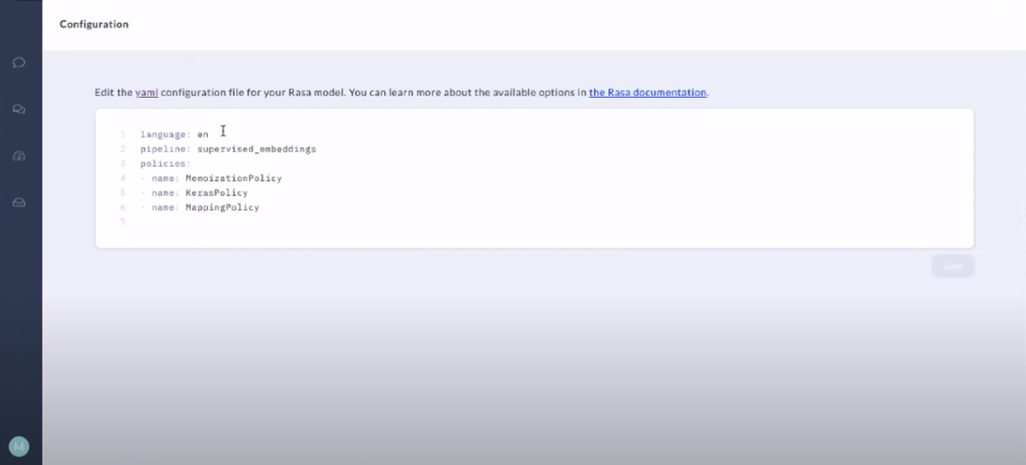
Rasa X
Solution

Slide 40
Data Improvement
Proposed Solution

Slide 41

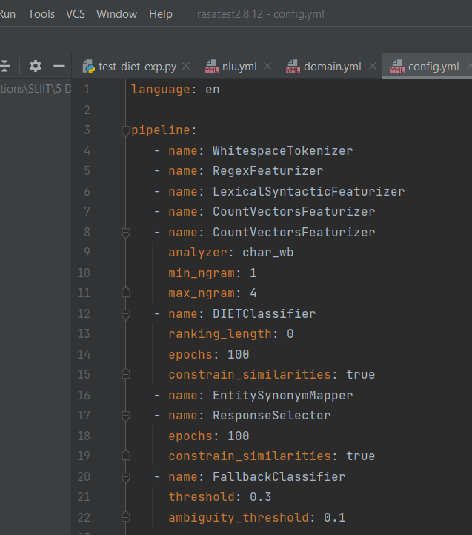


Modify Rasa NLU Configurations
Select an Intent Classifier:
DIET Classifier
Advanced Component Configurations:
Epochs
Ranking Length
Train

Slide 42
Data Improvement
Implemented Solution

Slide 43
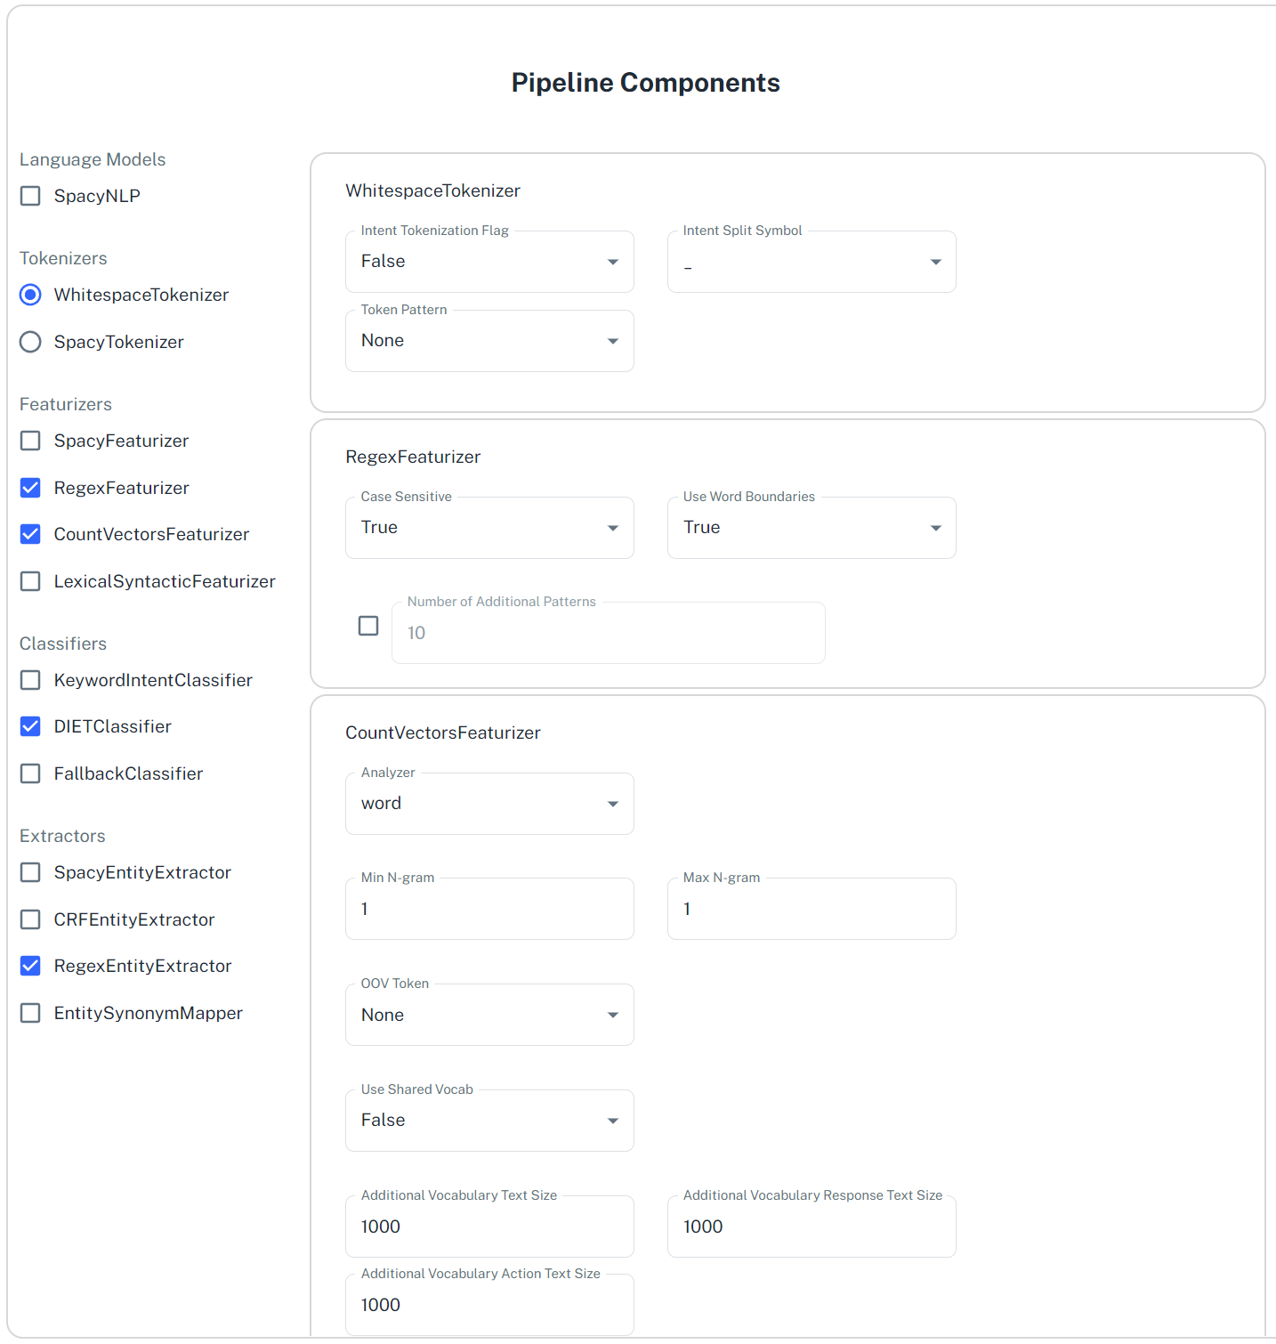
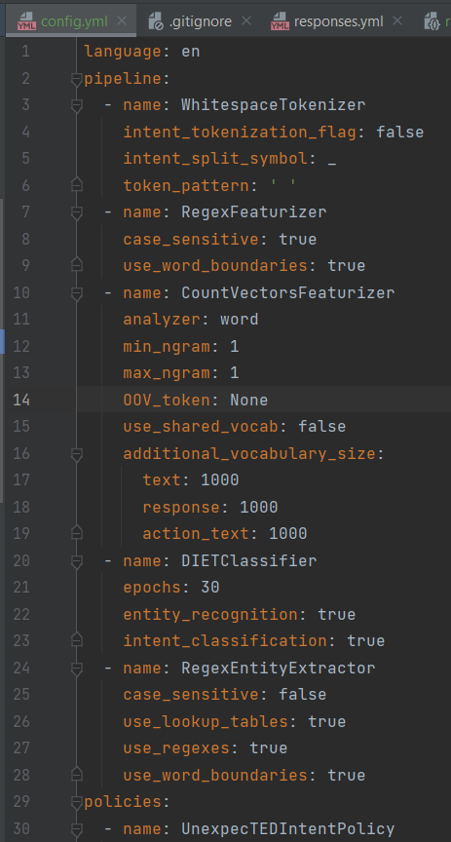
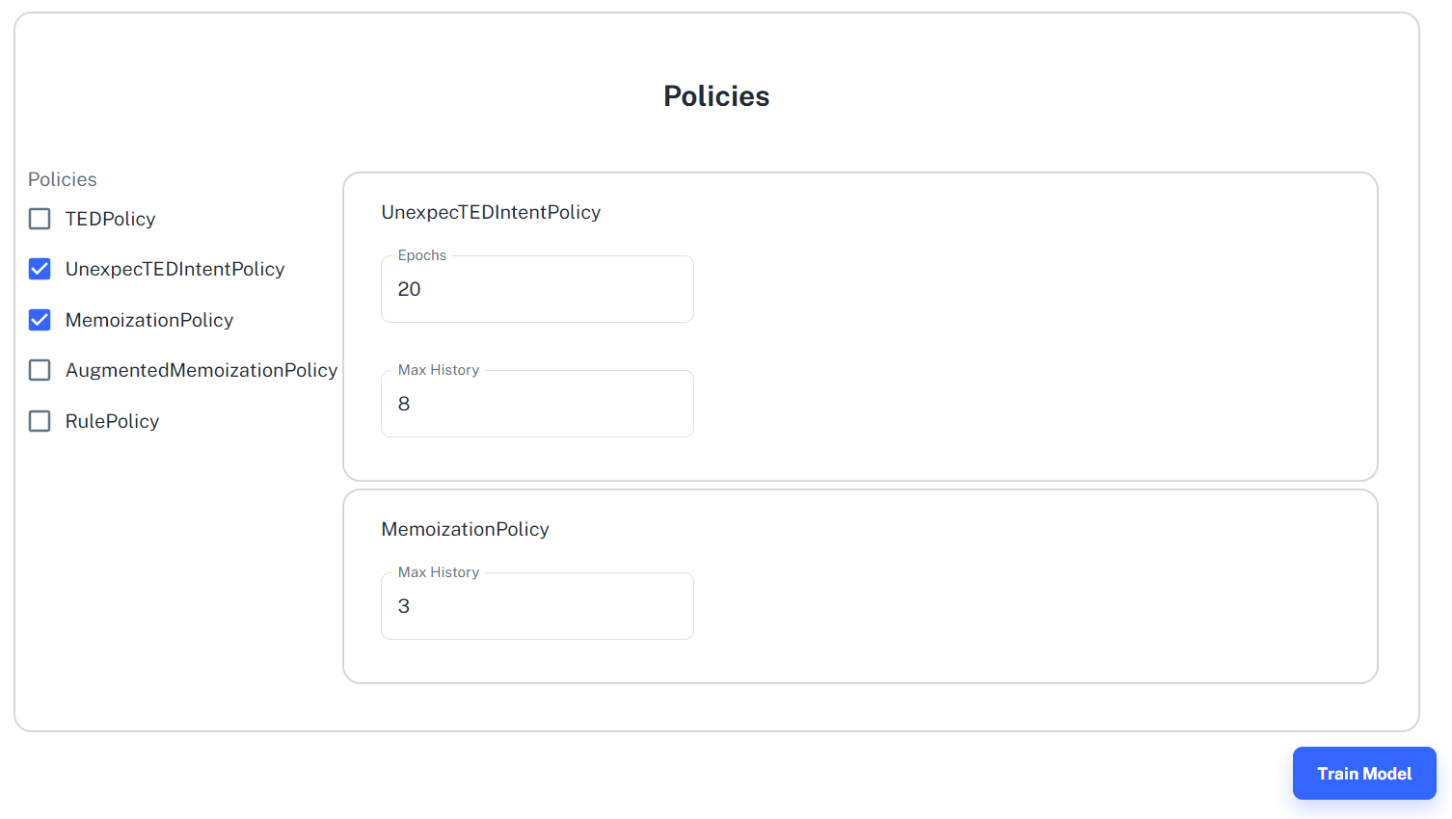
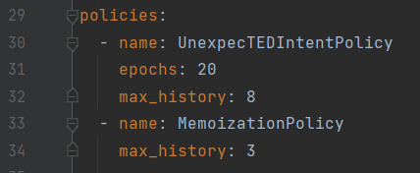

Slide 44
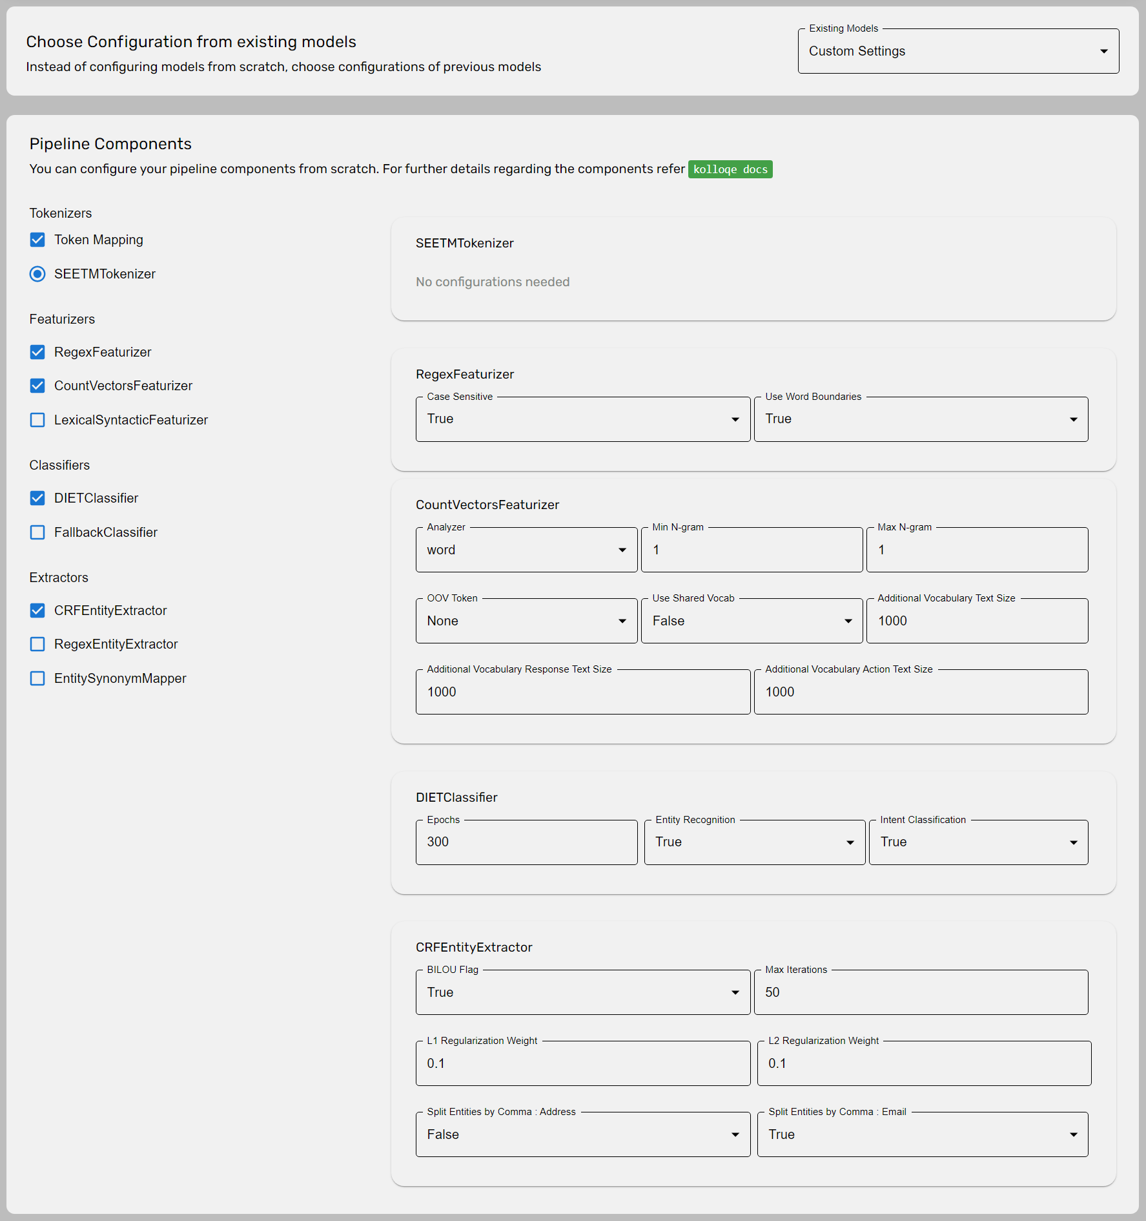
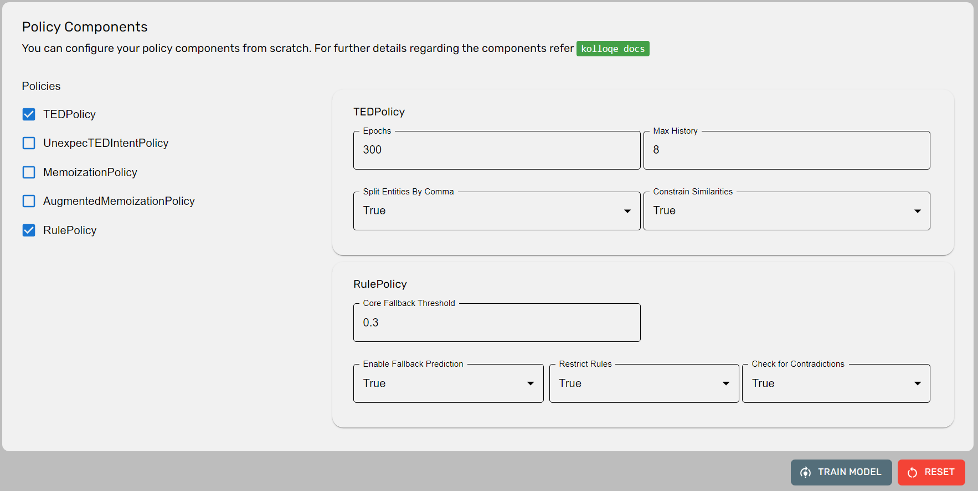
Version 2.0
Provides the option to set the pipeline and policy configurations using configurations from existing models
Added a custom tokenizer(SEETM) for token mapping
Added links to kolloqe documentation containing explanations for provided components

Slide 45
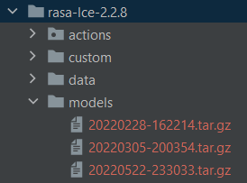
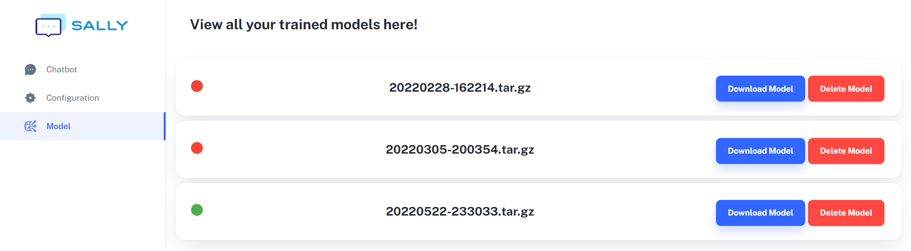
Trained
Models

Slide 46
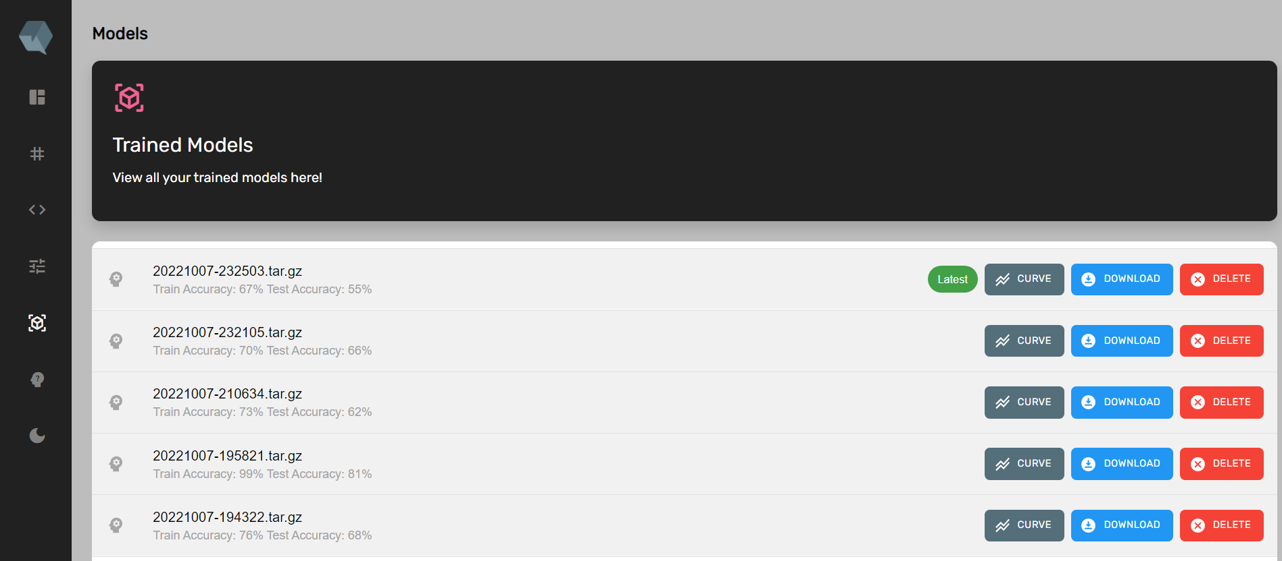
Trained Models
Version 2.0

Slide 47
Data Improvement Requirements
Functional Requirements
Non-Functional Requirements
Should be able to choose pipeline and policy components and train models without knowing what dependencies they require and the required order
Should increase the efficiency of training a model by reducing errors using the UI compared to manually typing the pipeline and policy components
Should be able to view trained models
Should reduce the time consumed to create the pipeline and policy components by reducing the
need to type by increasing clickable components
Should be able to suggest what the best epoch is to train a model based on the learning curves of a model

Slide 48

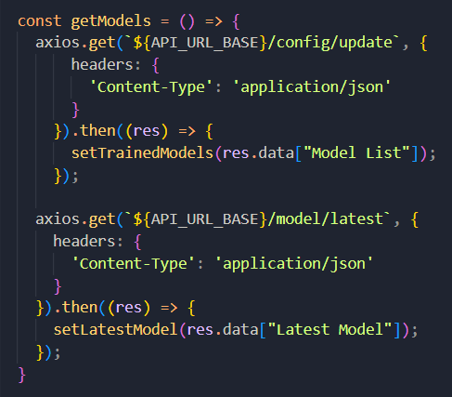

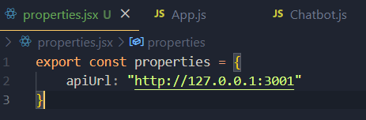

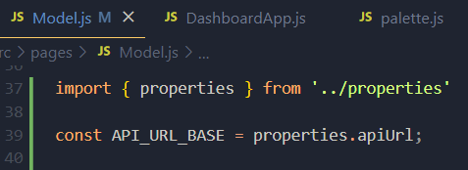
Best
Practices
Maintain a properties file for the front-end

Slide 49
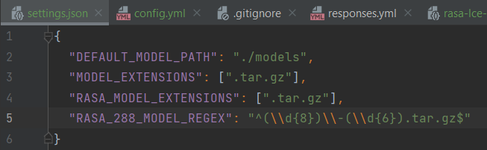
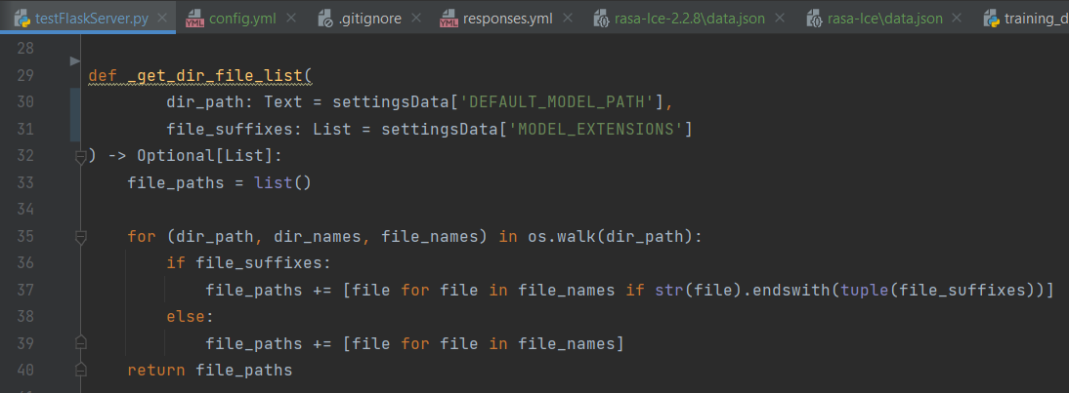
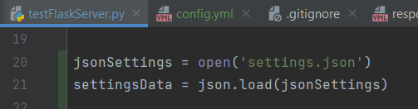
Best
Practices
Maintain a config file for the back-end

Slide 50
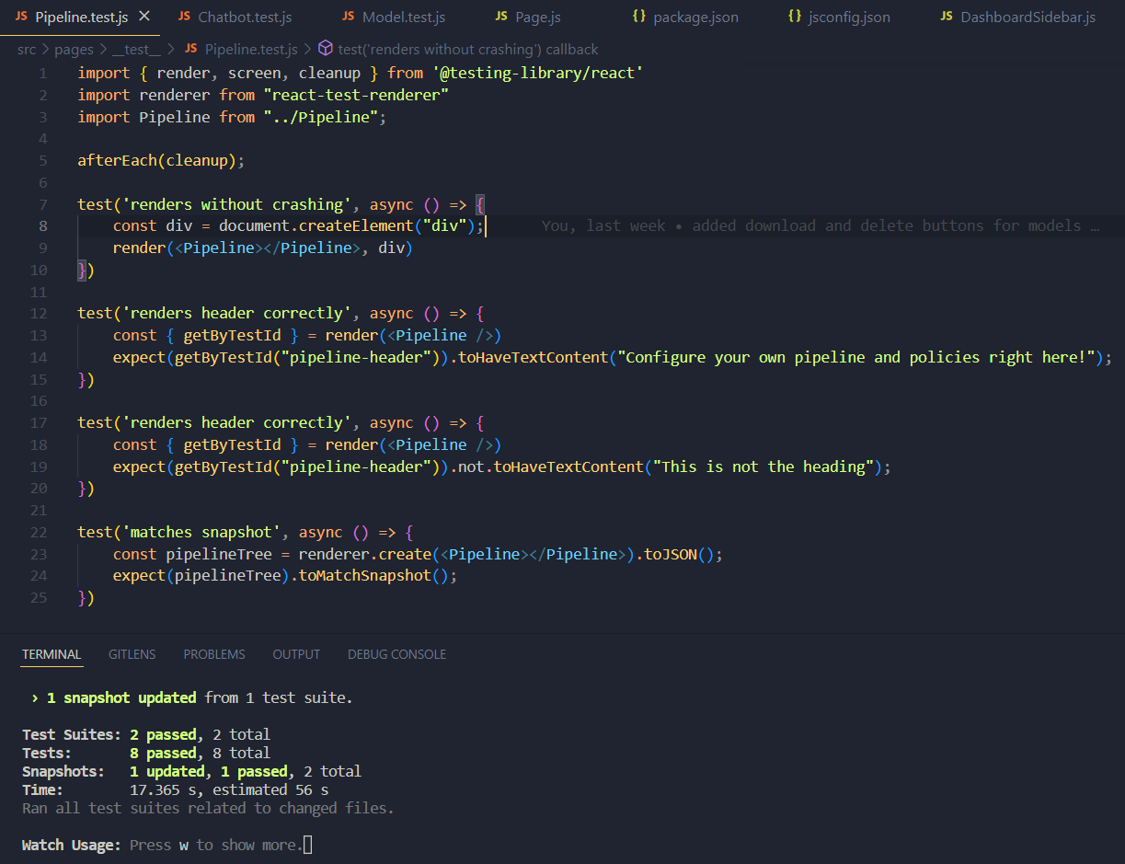

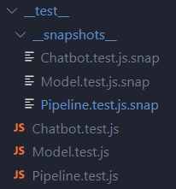
Test
Classes

Slide 51

Specific
Objective
Develop an efficient and code-less approach to improve and evaluate conversational AI machine learning models for non-machine learning experts

Slide 52

Sub
Objectives
95% * 0.1
Developing a solution for non-technical users to configure and efficiently retrain machine learning models.
100% * 0.6
100% * 0.3
Developing a solution for non-technical users to view all train models and evaluate them
Developing an algorithm to identify what the best epoch is to train a model and suggesting it in the UI.
98%
Overall completion = (objective completion) x (objective weight) =

Slide 53

Work Breakdown Structure
1
Data Preparation
Building Conversational AI
Algorithm Development
4
Implementation
Deployment
2
3
5
Data Collection
Add Training Data
Read TensorBoard Results
Integrate LCE with Rasa
Update the GIT Repository
Data Augmentation
Build NLU pipeline
Develop Learning Curve Explainer algorithm to interpret TensorBoard Results
Build the Frontend
Set up GCP Instance
Data Deduplication
Decide number of validation data points
Implement code-less Maintenance
Deploy Docker Containers
Data Preprocessing
Build Docker & Docker-compose files
Test LCE and Code-less Maintenance after Deployment
Enable TensorBoard
Build the LCE Package
Train a model
Build a Locally executable Server
Build Caddy and NGINX Servers
Testing NLU Model
Integrate component UI with the Main UI
Completed
In-progress (90% - 100%)
Pending

Slide 54


Technologies
Frontend Development
Backend Development
Project Management
React
Python
TensorBoard
Git
GitLab
GitHub
Rasa
Flask

Slide 55

References
[1]. T. Bocklisch, J. Faulkner, N. Pawlowski, en A. Nichol, “Rasa: Open source language understanding and dialogue management”, arXiv preprint arXiv:1712. 05181, 2017.
[2]. “Introduction to rasa X,” Open source conversational AI, 10-Dec-2021. [Online]. Available: https://rasa.com/docs/rasa-x/. [Accessed: 22-Jan-2022].

Slide 56

97.5%
SEETM: Sinhala-English
Equivalent Token Mapper
Developing rule-based approaches to process code-mixed textural data and make word embeddings models lightweight using token mapping.
Jayasinghe D.T.
IT19075754
Data Science

Slide 57



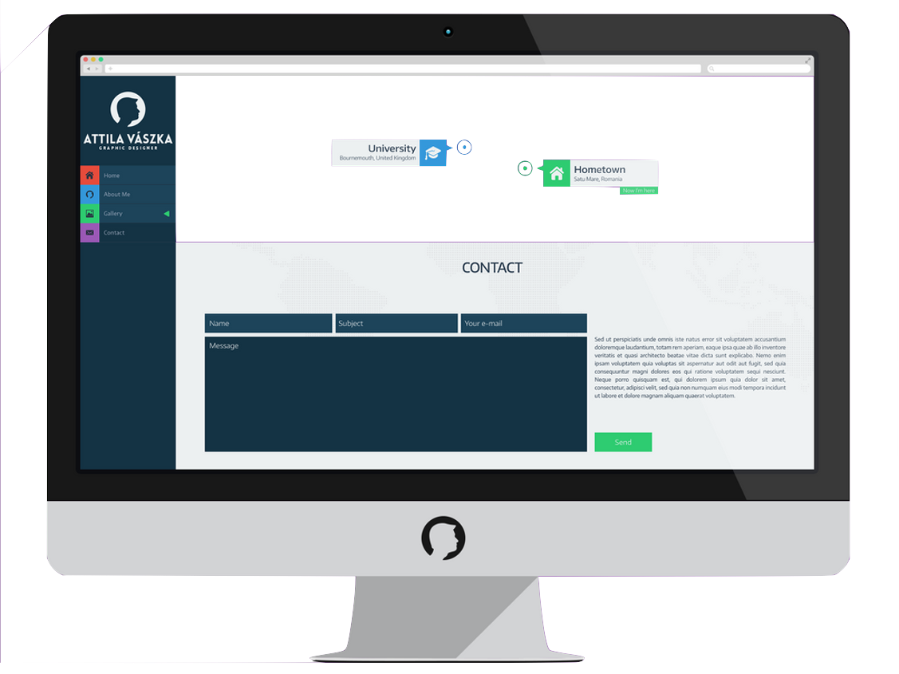
Oh, there’s a chatbot now I can communicate in Sinhala easily
How can I type Sinhala words?
Without converter, there’s no way to type Sinhala using keyboard
There’s no Sinhala support chatbots even

Slide 58

Solution Found !

Slide 59

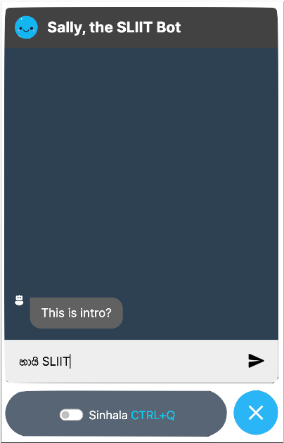
Sinhala-English code-switchable Keyboard Interface
Code-Switching
Library Membership
එකට apply
කරන්නේ කොහොමද?

Slide 60


Functional Requirements
Ability to type in Sinhala using an English keyboard.
Ability to switch between typing Sinhala and English
Ability to type emojis if required
SEETM should handle out-of-vocabulary words in Word2Vec models when at least one of the representations of equivalent tokens are present in training data.

Slide 61

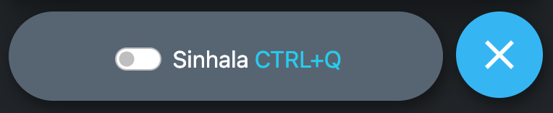
Non-Functional Requirements
Efficiency
Usability
Reliability
Scalability
Modularity

Slide 62






Research Flow
Web Chat
Component
Sinhala-English Keyboard Interface
Users
Conversational AI User Interface
Get Data on Key Press/ Key Up/ Key Down Events
Apply Rules in order
Return the converted Text

Slide 63
Keyboards
Comparison
Keyboard Name | Default (Misleading character Map) | Changes
Helakuru Keyboard (හෙළකුරු) | Backspace + a → ා c → ක් u → ෞ (when re-enter) ou → ඖ Q/q → ද් | Backspace + a → අ c → ච් u → උ au → ඖ Q/q → (Shortcut) (dh → ද්)

Slide 64
Keyboards
Comparison
Keyboard Name | Default (Misleading character Map) | Changes
UCSC Unicode Real-Time Font Converter | c → c q → ඣ් Q → Q U → U V → V E → E F → F H → H M → M O → O S → S W → W x, X → x z→ z | c → ච් Q/q → (Shortcut) U → උ V → ව් E → ඓ F → ෆ් H → ඃ M → ම් O → ඖ S → ස් X → ඞ් x → ං W → ව් z → ර්‍

Slide 65

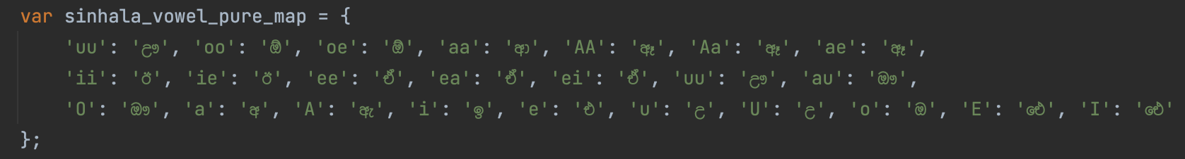
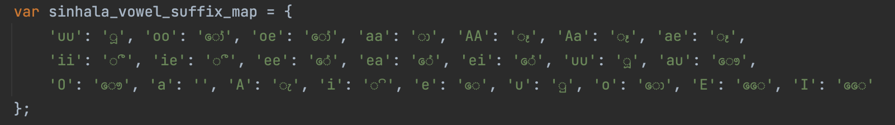
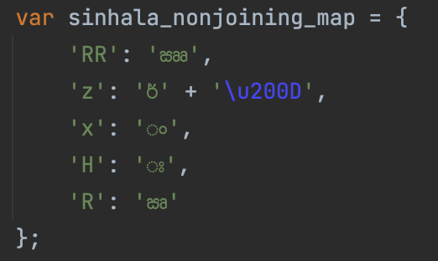
Character Mapping

Slide 66
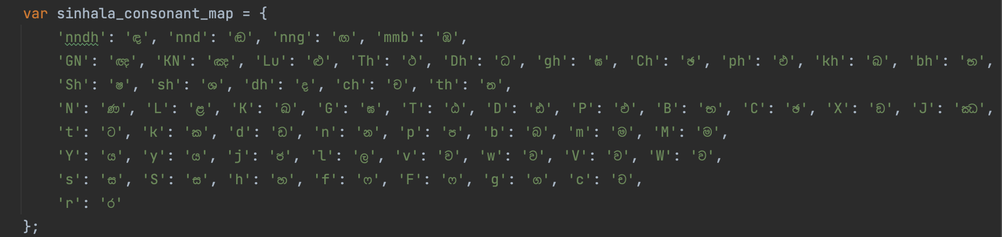
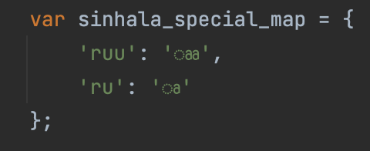
Character Mapping

Slide 67

Keyboard Interface Ruleset
Input
aakramaNaya
saxskruthiya
:alien:
Rule #0
aakramaNaya
sa x skruthiya
👽
Emojis
Rule #1
aakramaNaya
sa ං s kru thiya
👽
Non-joining
[ඎ, ං , ඃ, ඍ]
Rule #2
aa kra maNaya
saංs කෘ thiya
👽
Special
[ෲ, ෘ,]
Rule #3
aa ක්‍ර ma Na ya
sa ංsකෘ thi ya
👽
Rakaranshaya
[්‍ර]
Rule #4
aa ක්‍ර ම ණ ය
ස ං s කෘ ති ය
👽
Consonants + Vowel Suffixes
[ස, ක, ම.. ]
Rule #5
aa ක්‍ර ම ණ ය
සං ස් කෘතිය
👽
Consonants + Hal
[ස්, ක්, ම්.. ]
Rule #6
ආ ක්‍රමණය
සංස්කෘතිය
👽
Pure Vowels
[අ , ආ, ..]
ආක්‍රමණය
සංස්කෘතිය
👽

Slide 68

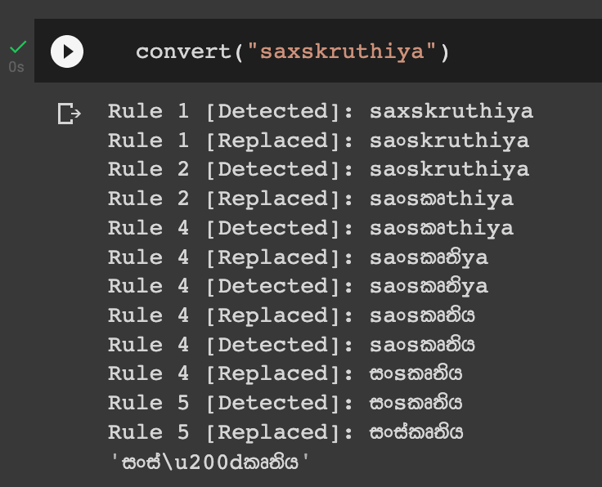
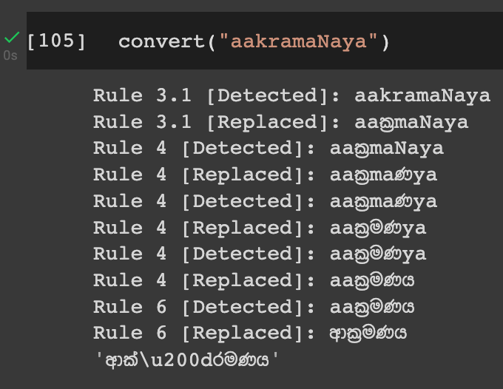
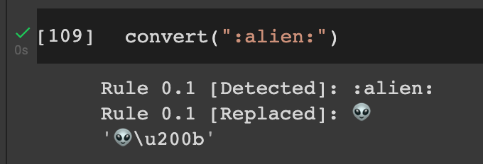
Rule Activation
සංස්කෘතිය
ආක්‍රමණය
👽

Slide 69
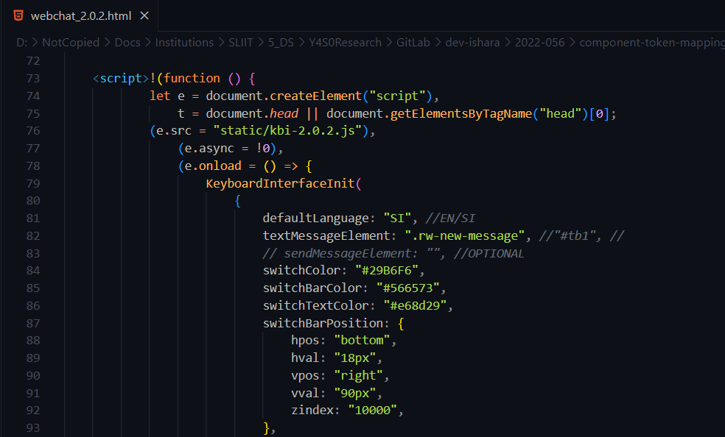
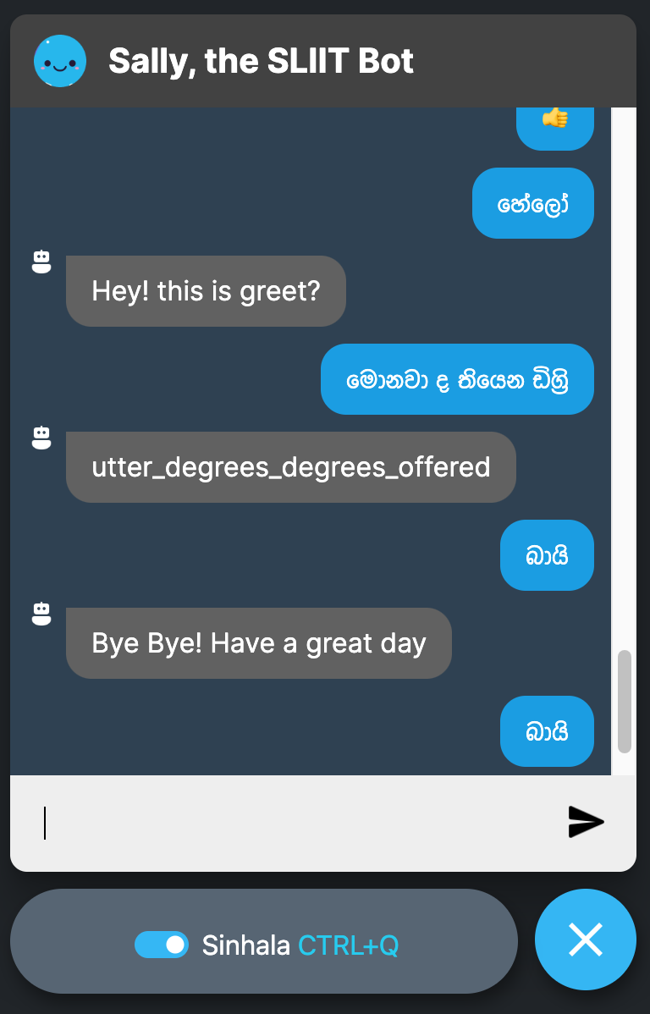
HTML Script tag...
Keyboard works on chatbot
Attachable script tag for keyboard interface

Slide 70

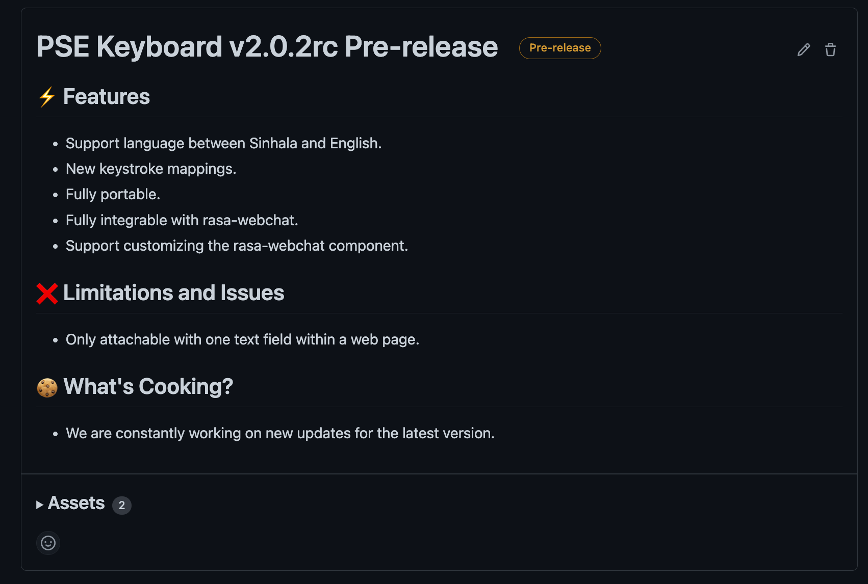
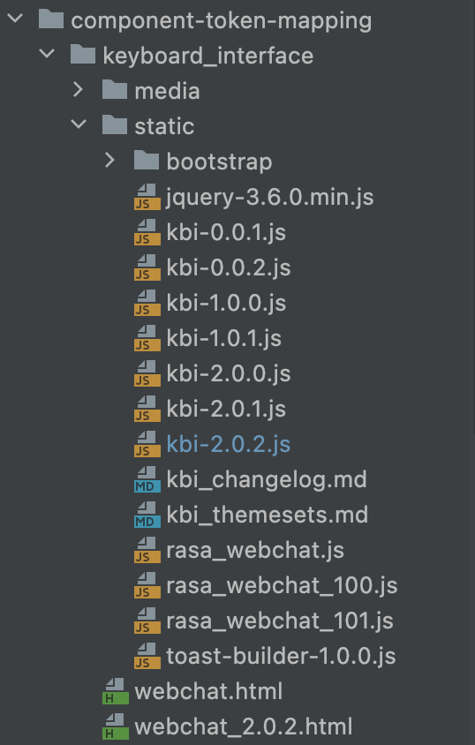

Best Practices
1
Release a
Pre-release
2
Implemented
Versions

Slide 71
Work Breakdown
Structure
SEETM
1
Data Preparation
SEETM Algorithm Development
Sinhala-English Code-Switching Keyboard Interface
4
Implementation
Deployment
2
3
5
Data Collection
Develop Sinhala-English Character Map
Develop the Keyboard Interface Using Keystroke Mapping
Integrate SEETM with Rasa
Update the GIT Repository
Data Augmentation
Build Docker Images
Set up GCP Instance
Develop Equivalent Token Mapping Algorithm: SEETM
Data Deduplication
Utilizing the Character Map within the Keyboard Interface
Write Docker Compose Configs
Deploy Docker Containers
Data Preprocessing
Evaluate Token Mapping Manually
Build Caddy and NGINX Servers
Test SEETM and Keyboard Interface after Deployment
Training a Word2Vec Model
Enable Efficient Language Switching
Integrate component UI with the Main UI
Evaluating Token Mapping Effect on Word2Vec Model
Completed
In-progress (90% - 100%)
Pending

Slide 72


Specific
Objective
Assigning the same word vector to equivalent words in a Sinhala-English code-switched text corpus

Slide 73

Sub
Objective
95% * 0.4
100% * 0.5
OOV words Handling in
word embeddings
Bilingual Keyboard Interface
95% * 0.1
Lightweight
Word Embedding Models
Overall completion = (objective completion) x (objective weight) =
97.5%

Slide 74
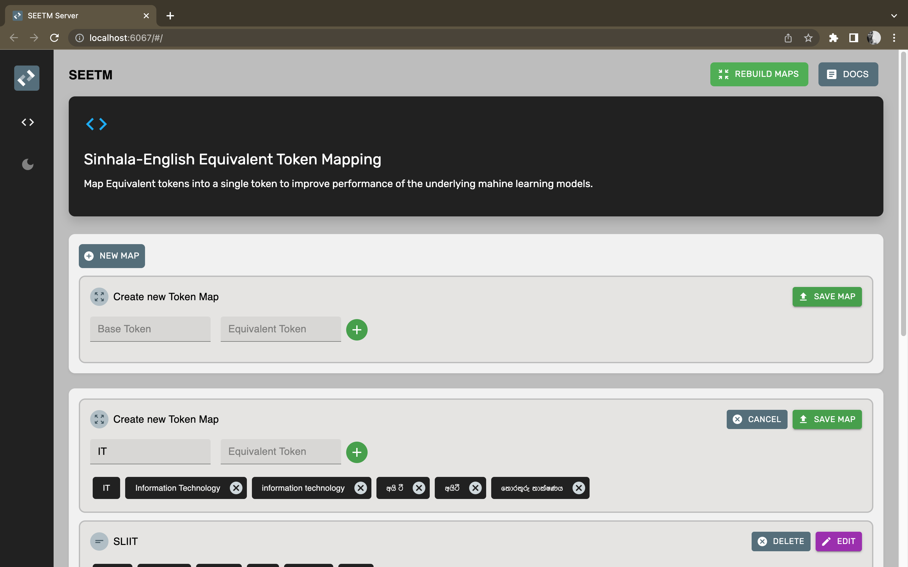

Slide 75

References
[1]. T. KasthuriArachchi and E. Y. A. Charles, "Deep Learning Approach to Detect Plagiarism in Sinhala Text," 2019 14th Conference on Industrial and Information Systems (ICIIS), 2019, pp. 314-319, doi: 10.1109/ICIIS47346.2019.9063299.
[2]. A. Kugathasan and S. Sumathipala, "Standardizing Sinhala Code-Mixed Text using Dictionary based Approach," 2020 International Conference on Image Processing and Robotics (ICIP), 2020, pp. 1-6, doi: 10.1109/ICIP48927.2020.9367353.

Slide 76

DIME: Dual Interpretable
Model-Agnostic Explanations
Using global explanations to generate local interpretations
in intent classification models using explainable AI
99%
Dissanayake D.M.I.M.
IT19069432
Data Science

Slide 77
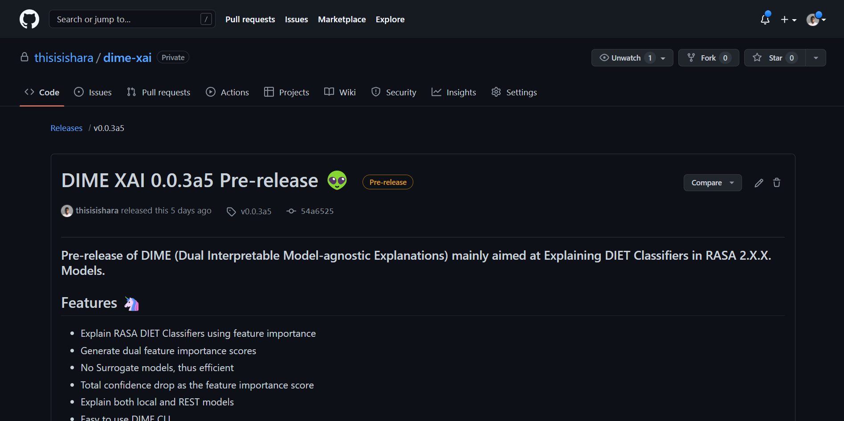
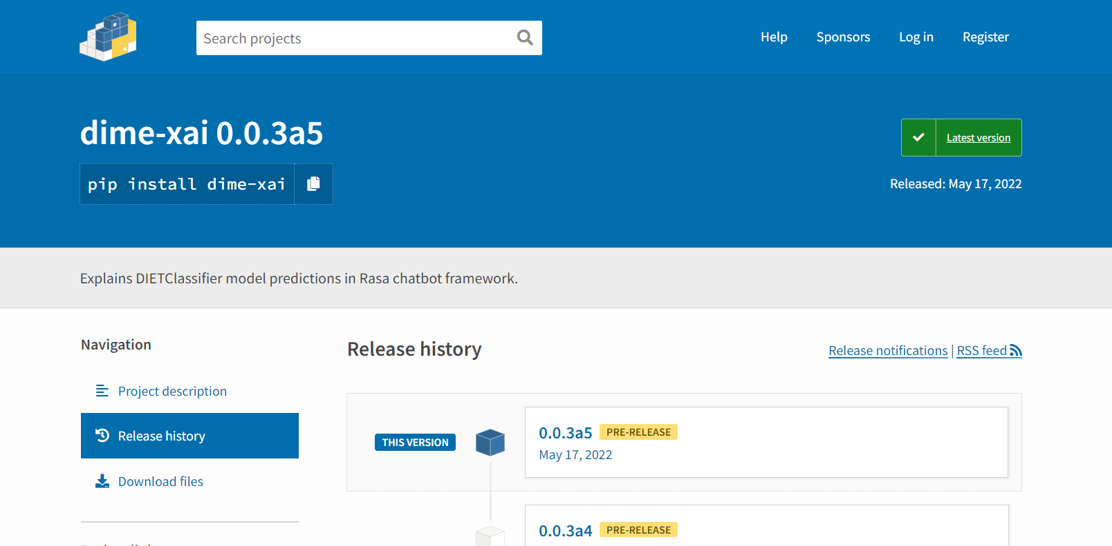
DIME Python Package

Slide 78

Functional Requirements
DIME should provide methods to calculate global and local explanations
DIME should provide a local server as a visualization tool
DIME should be applicable to any text classification model that outputs confidence scores for predictions
DIME should provide adjustable configurations required for explanations
DIME should utilize caching to optimize calculations

Slide 79

Non-functional Requirements
Efficient Calculations
Reliable Explanations
Simple & Interpretable Visualizations
Modular package

Slide 80
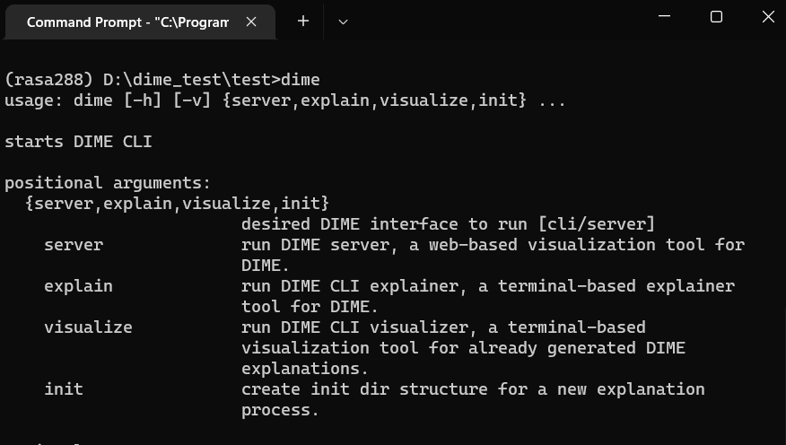

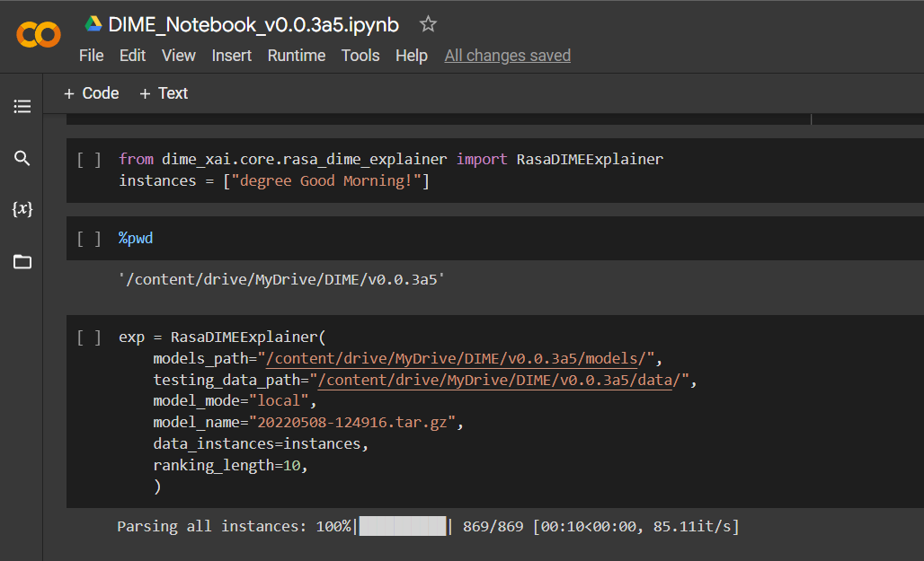

DIME Interfaces
CLI Interface
(terminal)
GUI Interface
(Web)
Python API
(Python/Jupyter)

Slide 81

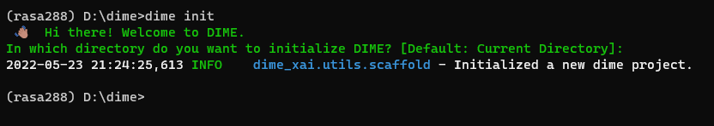
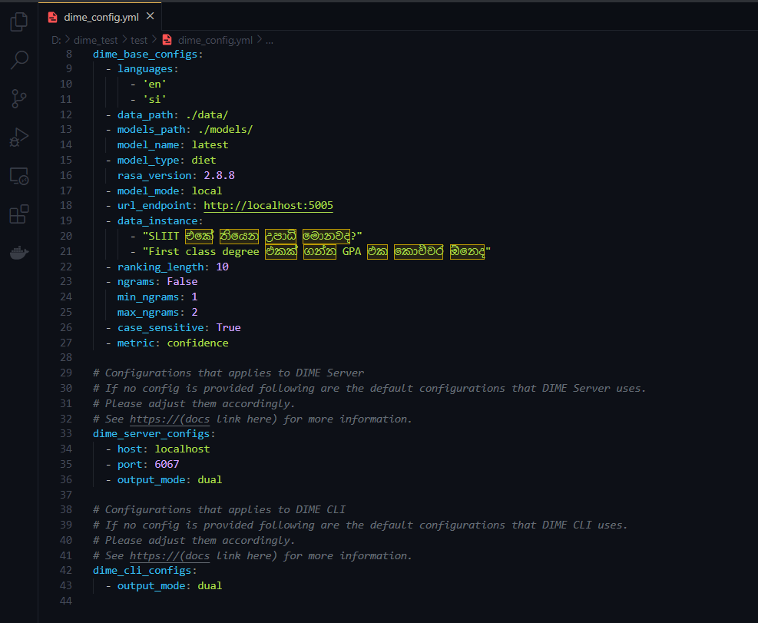

DIME Project

Slide 82


Generating DIME Explanations
Request Model Explanations (XAI)
dime_config.yml
Developers and Testers
DIME Web Server/ CLI/ Python API
Getting Data instance and user configs
Trained RASA Model
Retrieve default DIME Configs
DIME Cache Directory
Generate DIME Explanations
Visualize DIME Explanation
DIME Explanations Directory
Download Explanation as a JSON file

Slide 83

DIME Algorithm
Input Data
Tokenize
Preprocess
Calculate Global feature importance per token
Calculate local feature importance
Feature Selection
Cache
Explanation object
Persist as JSON
Visualize

Slide 84

Dual Feature Importance Metric
It is recommended to use model confidence as the metric
Finding Global Feature Importance for “මොනවද ”:
Why?
Original Dataset
Observe the Accuracy
Confidence is less sparse
DIME supports Accuracy and F1-Score, however they are highly sparse
Removing “මොනවද ”
Altered Dataset
Observe the Accuracy
Global Feature Importance of “මොනවද ” = Accuracy Difference
Confidence Difference

Slide 85






Accuracy
F1-score
Model Confidence
Feature Selection when metric is “Accuracy”, or “F1-Score” is biased since ordering tokens with the same score is always the same.

Slide 86


Dual Feature Importance Probabilities
Problem:
Exp norm Softmax Scores
Solution:
Probability Scores
Unrealistic Importance Scores

Slide 87

DIME Algorithm cont.

Slide 88


Comparison LIME vs DIME
Problem with LIME
DIME
Letter-wise Importance is given for SI

Slide 89
Best Practices
The Code
Releases
Threading
Git
GitLab
GitHub
Docstrings
PyPI
PEP8
Test PyPI

Slide 90



Docstrings & PEP8
Threading for parsing RASA model
Test PyPI alpha version release

Slide 91

Specific Objective
Develop DIME, an Explainable AI approach to deliver local model explanations with the help of global feature importance.

Slide 92

Sub Objectives
100% * 0.4
95% * 0.15
100% * 0.05
Find Global and Local Explanations logically
Develop a python package for DIME
Modify DIET intent classifier to get all confidence scores
100% * 0.3
100% * 0.1
Visualize explanations in an interpretable manner
Integrate DIME with Rasa seamlessly
Overall completion = (objective completion) x (objective weight) =
99.25%

Slide 93

Work Breakdown
Structure

Slide 94
DIME
1
Data Preparation
Conversational AI Building
Algorithm Development
4
Implementation
Deployment
2
3
5
Data Collection
Add Training Data
Global Feature Importance
Integrate DIME with Rasa
Update the GIT Repository
Data Augmentation
Build NLU pipeline
Local Model Explanations
Build Docker Images
Set up GCP Instance
Data Deduplication
Modify DIET Classifier
Build the DIME Core Package
Write Docker Compose Configs
Deploy Docker Containers
Data Preprocessing
Train a model
Develop local Visualizations Server
Build Caddy and NGINX Servers
Test DIME after Deployment
Integrate component UI with the Main UI
Compare and Evaluate DIME explanations with LIME
Completed
In-progress (90% - 100%)
Pending

Slide 95

References
[1]. M. T. Ribeiro, S. Singh, C. Guestrin, “‘why should I trust you?’: Explaining the predictions of any classifier,” 16 Feb 2016. [Online]. Available: https://arxiv.org/abs/1602.04938
[2]. S. Lundberg, S. Lee, “A Unified Approach to Interpreting Model Predictions,” 2017. [Online]. Available: https://arxiv.org/abs/1705.078744
[3]. T. Bunk, D. Varshneya, V. Vlasov, A. Nichol, “DIET: Lightweight Language Understanding for Dialogue Systems,” 2020. [Online]. Available: https://arxiv.org/abs/2004.09936

Slide 96




DEMO PACKAGE
ON PREM PACKAGE
$ 199.99 one time
2 Free Maintenance
($9.99 per additional call)
Bot Analytics + CDD
FREE for one month
10 Intents
2 API Integrations
Unlimited CDD Improvements
No Bot Analytics
Business Model
STARTER
CaaS PACKAGE
$ 9.99/Month
20 Intents
2 API Integrations
No Bot Analytics
Unlimited CDD Improvements
PRO
$ 34.99/Month
180 Intents
20 API Integrations
Bot Analytics
CDD
Sinhala Entity Annotation
GENIUS
$ 49.99/Month
400 Intents
50+ API Integrations
Bot Analytics Included
CDD + ML Packages

Slide 97

DEMO PACKAGE
FREE for one month
10 Question Categories
Entity Annotation
Model Evaluations
Model Explainability
$ 299.99 one time
1 Free Maintenance
($50.00 per additional call)
Question Categories
All ML Tools
ON PREM PACKAGE
STARTER
PRO
GENIUS
$ 9.99/Month
$ 34.99/Month
$ 49.99/Month
CaaS PACKAGE
100 Question Categories *
Entity Annotation
Model Evaluations
Model Explainability
20 Question Categories
Entity Annotation
Limited Model Evaluations
No Model Explainability
50 Question Categories
Entity Annotation
Model Evaluations
Limited Model Explainability

Slide 98
Thank You

Slide 99

Demonstration

Slide 100


Any Questions

